Slide 1

IWS USER APP – USER FLOW DOCUMENTATION

Slide 2
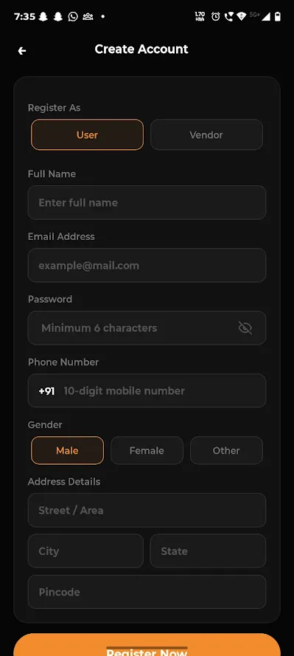
1. User Registration
When users open the IWS application for the first time, they can create a new account using the Register Page. Users must enter the required details such as:
Full Name
Email Address
Mobile Number
Password
After submitting the details successfully, the user account will be created and ready for login.

Slide 3
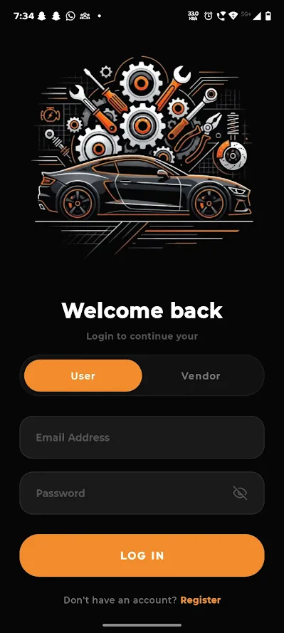
2. User Login
After registration, users can log in using the registered Email ID and Password through the Login Page.
Once login is successful, users will be redirected to the Home Page of the application.

Slide 4
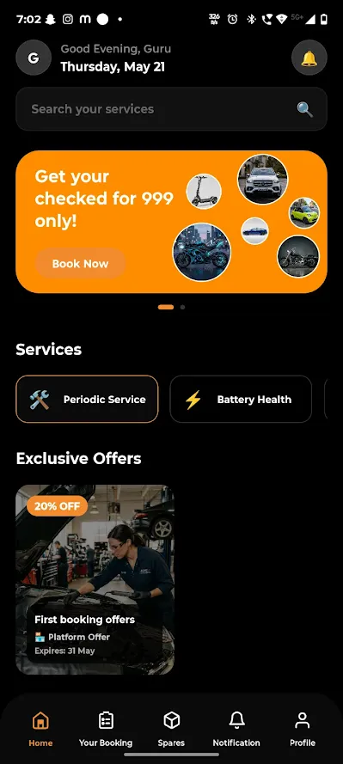
3. Home Page & Service Category Selection
On the Home Page, all available vehicle service categories will be displayed.
Examples:
Bike Services
Car Services
Heavy Vehicle Services
Users can select the required service category based on their vehicle type.

Slide 5
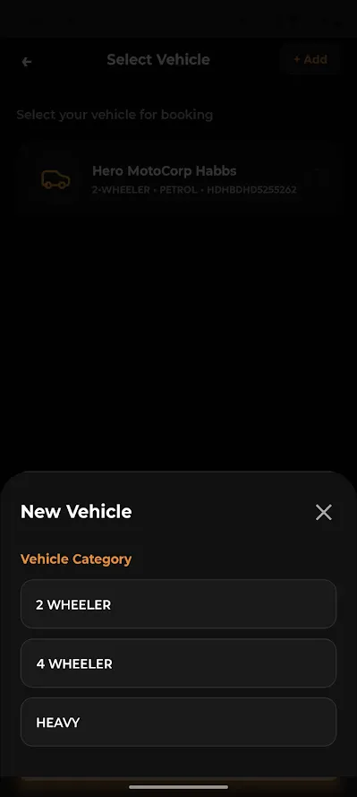
4. Vehicle Registration
After selecting a service category, users must register their vehicle details.
Vehicle registration includes:
Vehicle Name
Vehicle Number
Vehicle Model
Vehicle Type
The registered vehicle details will be saved for future bookings.

Slide 6
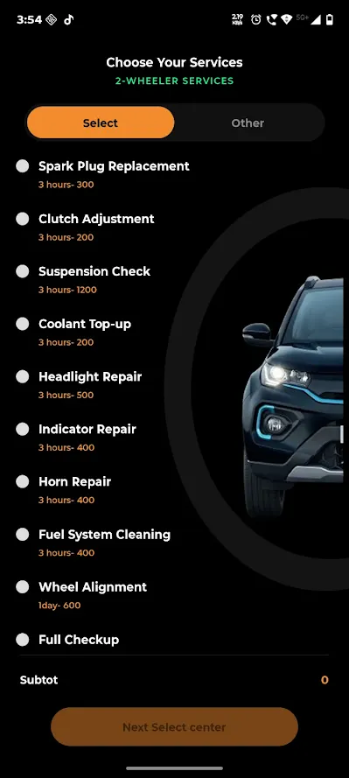
5. Service Selection & Manual Report
Users can then choose the required services for their vehicle.
Additional features available:
Select service type
Add manual issue report
Enter emergency service request details
This helps the service center understand the vehicle condition before booking confirmation.

Slide 7
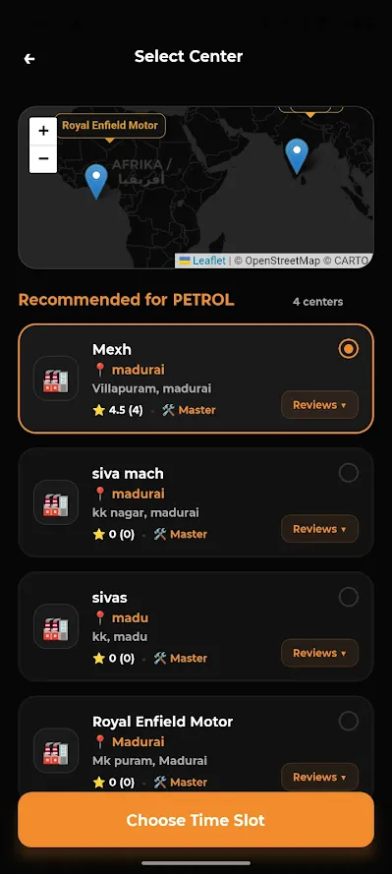
6. Service Center Selection
The application will display the available Service Centers based on the selected service category.
Users can:
View service center details
Check availability
Select the preferred service center

Slide 8
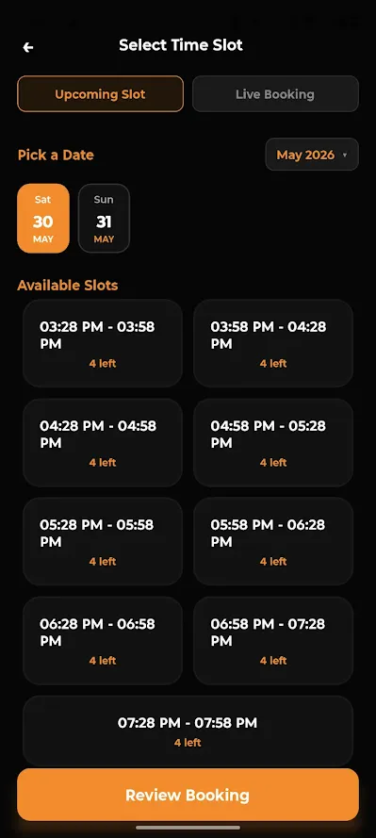
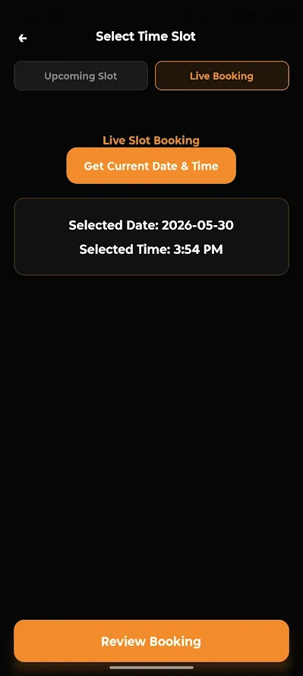
7. Time Slot Booking
After selecting the service center, users can choose the available Time Slot for service booking.
Available timings from the service center will be displayed dynamically.

Slide 9
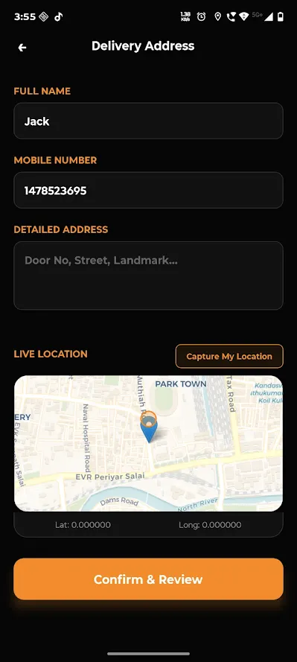
8. Address Details
Users must then enter the booking address details including:
Name
Phone Number
Address
City
Pincode
These details will be used for booking confirmation and service communication.

Slide 10
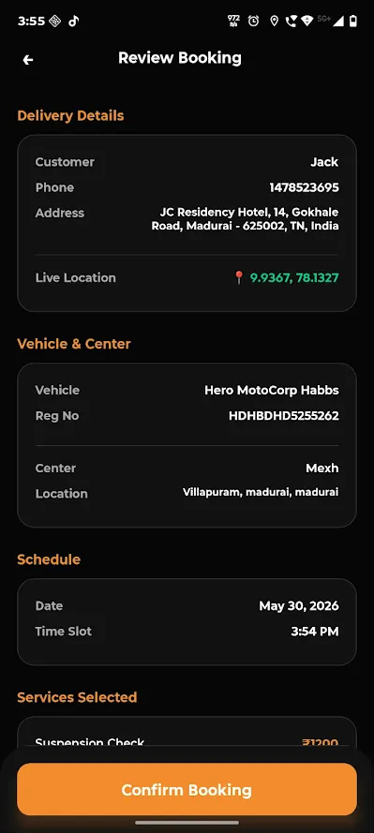
9. Booking Review Page
Before payment, the Booking View Page will display all booking information including:
Vehicle Details
Selected Services
Service Center Details
Booking Date & Time
Address Information
Total Amount
Users can verify all details before proceeding.

Slide 11
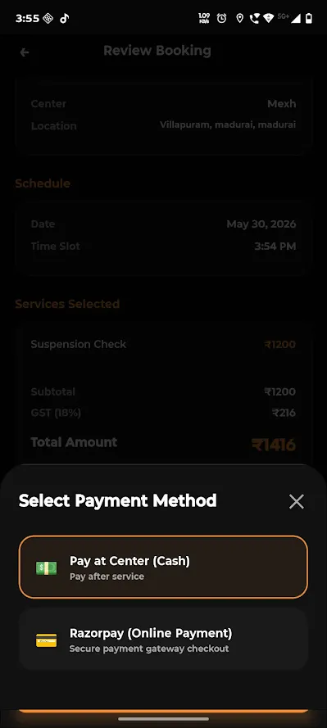
10. Payment Process
The application supports multiple payment methods:
Online Payment
Cash Payment
After successful payment, users will see the Payment Successful Page with booking confirmation details.

Slide 12
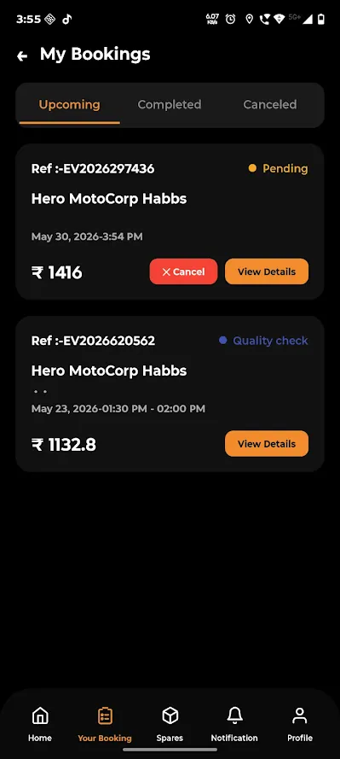
11. Booking Tracking
Users can track their booking status in real time through the Track Booking feature.
Booking stages include:
Booking Requested
Booking Accepted
Service In Progress
Completed

Slide 13
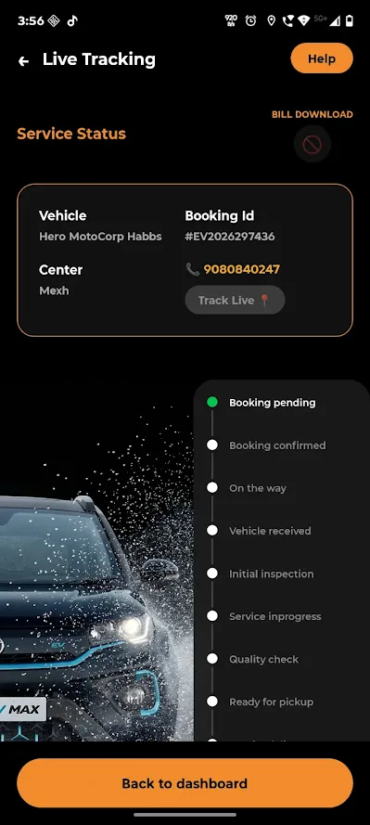
12. Your Orders Section
All booking history and active bookings will be available in the Your Orders section.
Users can:
View booking details
Open tracking information
Check service status

Slide 14
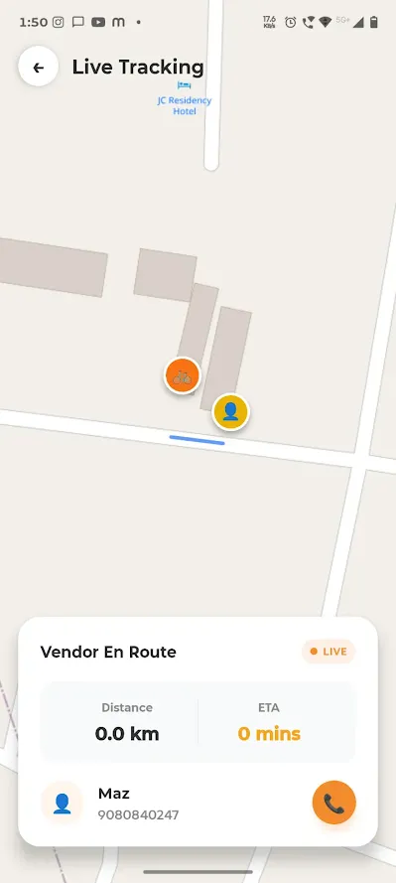
13. Live Vendor Tracking
Once the booking is accepted by the vendor/service person, users can track the service person live through the map tracking feature.
Tracking features include:
Live Location Tracking
Distance Information
Estimated Arrival Time (Minutes)

Slide 15
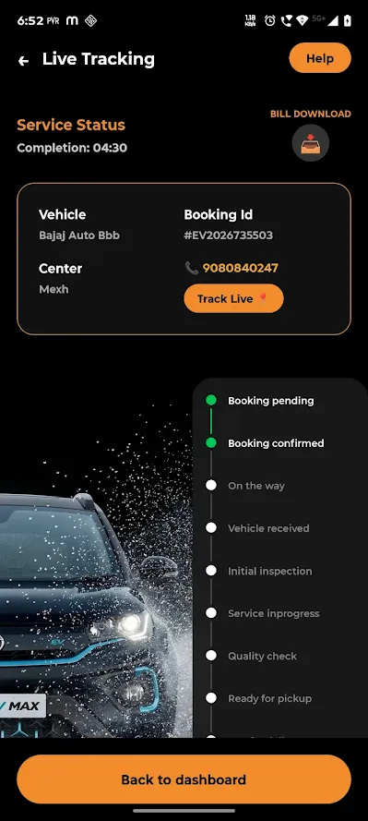
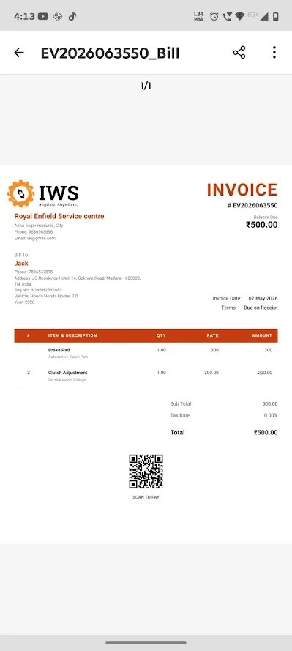
14. Bill Upload & PDF Download
After service completion:
Vendors can upload the service bill
Users can download the bill in PDF format
Complete service booking details can also be downloaded as PDF

Slide 16
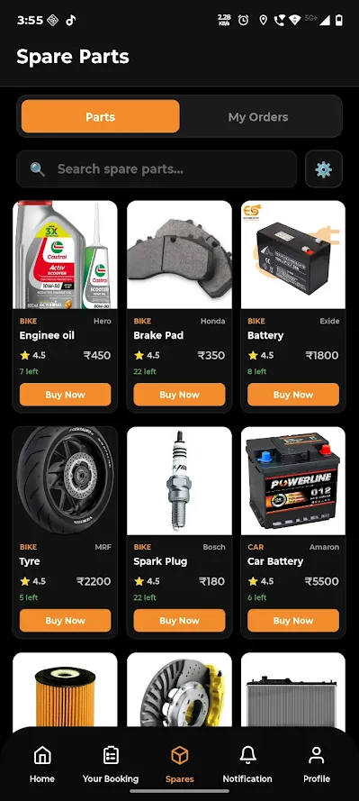
15. Spare Parts Purchase Module
Users can also purchase spare parts through the application.
Available spare parts categories:
Bike Spare Parts
Car Spare Parts
Heavy Vehicle Spare Parts
Features included:
Spare parts listing
Product details view
Order tracking
Delivery tracking

Slide 17
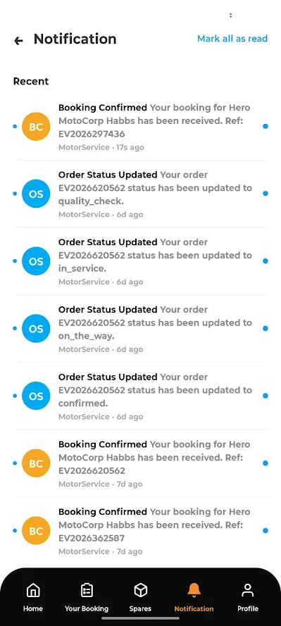
16. Notification Module
The Notification Page helps users receive real-time updates such as:
Booking confirmation
Payment updates
Service status updates
Offer notifications

Slide 18
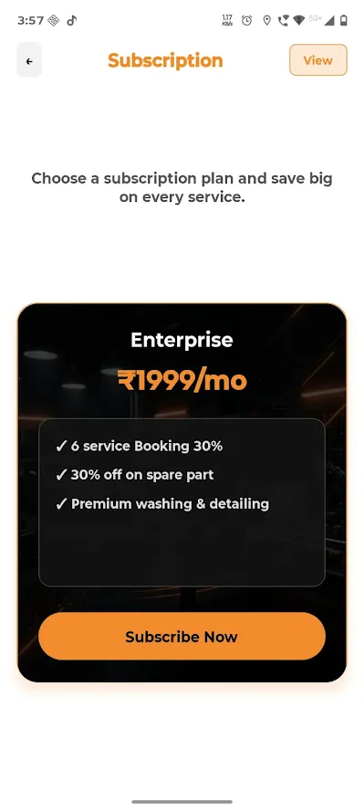
17. Subscription Page
Users can access the Subscription Page to view available subscription plans and benefits.
Subscription features include:
Plan Details
Pricing Information
Service Benefits
Subscription Activation

Slide 19
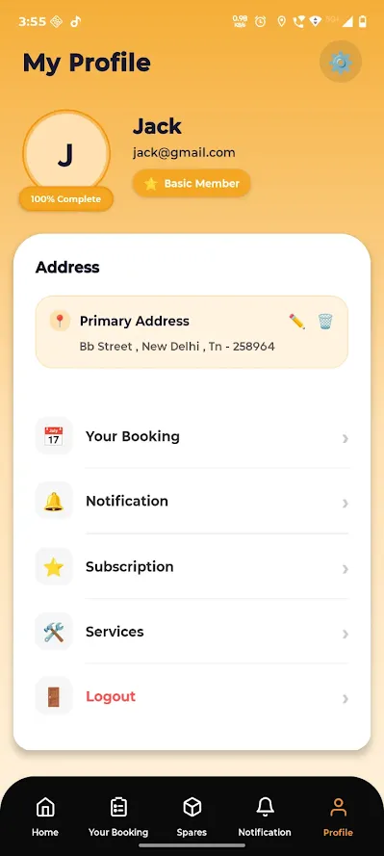
18. Profile Page
The Profile Page allows users to manage their personal information.
Users can:
Edit profile details
Update contact information
Manage saved vehicles
View account settings

Slide 20
Conclusion
The IWS User Application provides a complete end-to-end vehicle service management experience including vehicle registration, service booking, live tracking, online payment, spare parts purchase, billing management, and subscription services through a user-friendly interface.

